Slide 1


1
Introduction to Computing and Programming
C# Programming: From Problem Analysis to Program Design
3rd Edition

Slide 2
Chapter Outline
Programming Methodologies
C# and .NET
Types of Applications
Software Development Process
First C# Program

Slide 3
1. Programming Methodologies
Programming Methodologies
Structured Procedural Programming
Object-Oriented Programming

Slide 4
Programming Methodologies
Structured Procedural Programming
Older approach
Process oriented – focus first on the actions; then on the data needed for the actions
Uses top-down design to break problem into sub problems
Object-Oriented Programming
Newer approach
Object oriented – focus on objects; objects have both data and related actions
Uses classes for describing objects of same type

Slide 5
Structured Procedural Programming
Programs are written using functions with parameters and return values to pass data to and from functions
Program execution usually involves execution of a main function calling/invoking other functions
Example programming language: C

Slide 6
Diagram Used - Structure Chart
main function
(Payroll Program)
hours, rate
pay
hours, rate
pay
getPayData function
(reads hours worked and pay rate)
computePay function (computes pay)
printPay function (displays
pay)

Slide 7
Object-Oriented Programming
Programs are written using classes
Program execution usually involves creating and using objects
Example programming language: C#, Java

Slide 8
Object-Oriented Approach
Focus on objects the program will use
Applies concept of objects or entities from the real world and models it in the program
Entity – a person, place, or thing; normally a noun
Example: Employee entity represents employees in a company

Slide 9
Diagram Used – Class Diagram
Class diagram has three sections:
Top section contains name of the class
Middle section lists the data items/attributes
Bottom section shows what actions are to be performed on the data

Slide 10
Diagram Used – Class Diagram
Employee
class name

Slide 11
Diagram Used – Class Diagram
Employee
name
hoursWorked
payRate
data

Slide 12
Diagram Used – Class Diagram
Employee
name
hoursWorked
payRate
computePay
actions

Slide 13
Encapsulation
Class implements concept of encapsulation
Encapsulation – data (or attributes) are combined with actions (or behaviours) to form a class

Slide 14
Abstraction
Class implements concept of abstraction
Abstraction – description of the essential, relevant properties of an entity i.e. the characteristics (or attributes) and behaviours (or actions) that can describe the entity

Slide 15


Classes and Objects
A class is like a template from which objects are created
This is similar to jelly mould and jellies
Using one jelly mould, we can create many jellies of different colours but all of them will have the same shape or pattern

Slide 16
Object-Oriented Approach
In the same way, we can create (instantiate) many different objects of one class
An object is an instance of a class
Employee
Employee
name=Jane Tan
hoursWorked=45
payRate=72.00
Employee
name=John Lee
hoursWorked=40
payRate=50.00
name
hoursWorked
payRate
Employee
name=Ravi Nathan
hoursWorked=50
payRate=65.00
computePay

Slide 17
2. C# and Microsoft .NET
C# is one of the newer programming languages
C# is similar to C and also C++, another object-oriented programming language
C# has object-oriented class library similar to Java
C# works with Microsoft .NET

Slide 18
.NET
.NET is an environment in which programs run
It is not an operating system
It provides a platform for developing and running code that is easy to use
It is part of Microsoft Visual Studio.NET

Slide 19
.NET
.NET supports development using a number of programming languages: C#, C++, Visual Basic, and some third-party languages
Code from each of the languages are all compiled to the common Microsoft Intermediate Language (IL)
So applications can be written with one part using Visual Basic and another part using C#
When compiled, they are all translated to IL

Slide 20
Microsoft Intermediate Language
Microsoft Intermediate Language (IL)
is between high-level source code and native code (machine language code of particular computer)
not directly executable on any computer
not tied to any specific CPU platform
.NET’s Common Language Runtime (CLR) is needed to run IL code

Slide 21
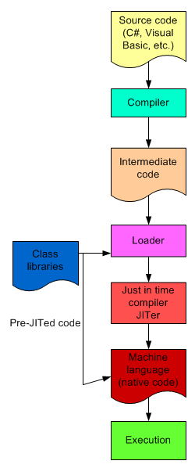
Common Language Runtime
CLR loads .NET classes used by the program
CLR performs second compilation called just-in-time (JIT) compilation using a tool called JITer
JITer converts IL code to the platform’s native code for execution

Slide 22
.NET
The .NET has a framework called .NET Framework which has a class library with over 2500 reusable classes available to any .NET language
C# was the language created for .NET and was designed from scratch to work with .NET
Most of the .NET Framework classes were written using C#

Slide 23
3. Types of Applications
Several types of application can be developed using C#:
Console-based applications
Windows graphical user interface (GUI) applications
Web applications
Class libraries and stand-alone components (.dlls)
Smart device applications, services

Slide 24
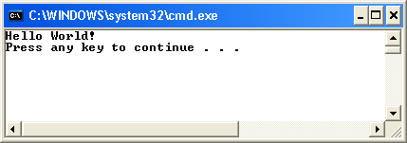
Console-based Applications

Slide 25
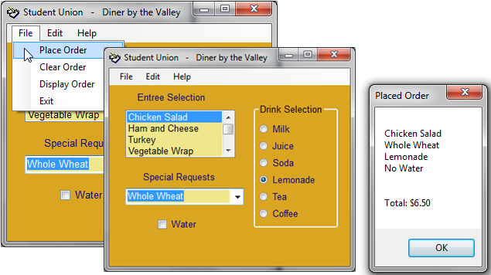
Windows Applications
Figure 1-15 Windows application written using C#

Slide 26
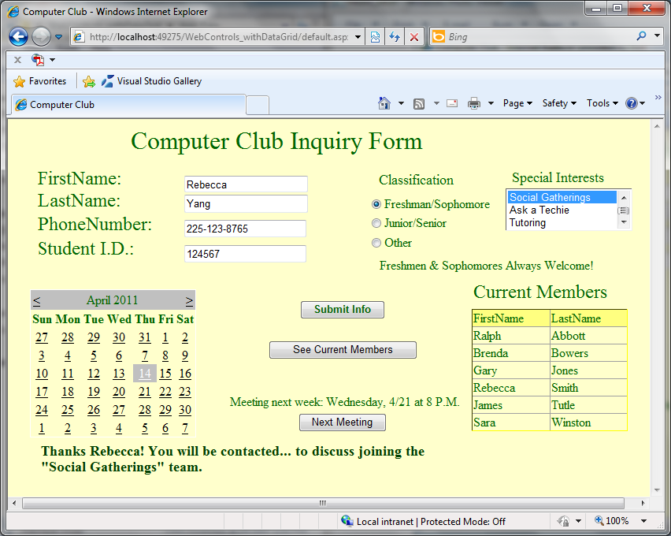
Web Applications

Slide 27
4. Software Development Process
Programming is problem solving
Programming involves following a organized plan or process i.e. a software development process

Slide 28

Steps in the Process
1. Analyze the problem
2. Design a solution
3. Code the solution (write the program)
4. Implement the code (compile the program)
5. Test and debug

Slide 29
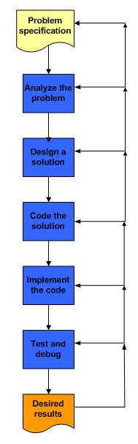

Slide 30
Steps in the Process
Start with problem specification
Analyze problem to understand exactly what the software is supposed to do
Review program inputs
For each program input, determine its type and domain/range of values

Slide 31
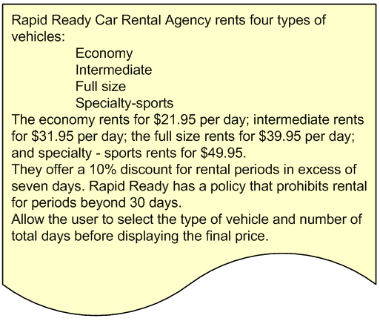
Example Problem Specification

Slide 32
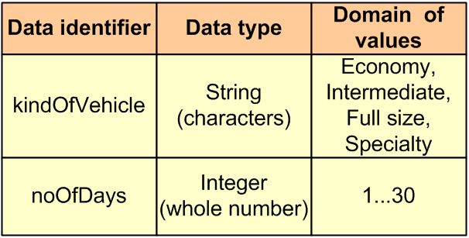
Program Inputs

Slide 33
Steps in the Process (cont’d)
Design a solution and verify that the design is correct
Code the solution by translating the design into source code
Implement the code by compiling the source code and correcting any compilation errors
Test the program and debug any logic or runtime errors

Slide 34
5. First C# Program
line 1 // This is traditionally the first program written.
line 2 using System;
line 3 namespace HelloWorldProgram
line 4 {
line 5 class HelloWorld
line 6 {
line 7 static void Main( )
line 8 {
line 9 Console.WriteLine(“Hello World!”);
line 10 }
line 11 }
line 12 }

Slide 35
Output from First C# Program

Slide 36
Comments
Inline comment:
// This is traditionally the first program written.
Multiline comment:
/* This is the beginning of a block multiline comment. It can go on for several lines or just be on a single line. No additional symbols are needed after the beginning two characters. Notice there is no space placed between the two characters. To end the comment, use the following symbols. */

Slide 37
Namespace
line 3 namespace HelloWorldProgram
line 4 {
. . .
line 12 }
User-defined namespace
Provides a way to group related things together
The namespace is optional

Slide 38
using Directive
Syntax
using namespaceIdentifier;
Permits use of class found in specific namespace without qualifying them
Example: using System;
System is a namespace in the .NET Framework Class Library containing a collection of frequently used classes e.g. Console class

Slide 39
using Directive
If using directive not include in above program, Console class name must be qualified
Example:
System.Console.WriteLine(“Hello World!”);

Slide 40
Class Definition
line 5 class HelloWorld
line 6 {
. . .
line 11 }
User-defined class
Every program must have at least one class

Slide 41
Method Definition
line 5 class HelloWorld
line 6 {
line 7 static void Main( )
line 8 {
. . .
line 10 }
line 11 }
Object-oriented programming languages contains method definitions that must be placed in class definitions

Slide 42
Main() Method Definition
line 7 static void Main( )
line 8 {
. . .
line 10 }
Execution always starts with Main() method
Applications must have one Main() method
void signifies no value returned
() signifies no parameters

Slide 43
Method Call
line 7 static void Main( )
line 8 {
line 9 Console.WriteLine(“Hello World!”);
line 10 }
Main() method calls WriteLine() method of Console class
“Hello World!” is the string argument value passed to the method

Slide 44
Write and WriteLine Methods
WriteLine( ) automatically advances to next line
Write( ) does not advance to next line
Write(“An example\n”);
Same as WriteLine(“An example”);

